Slide 1
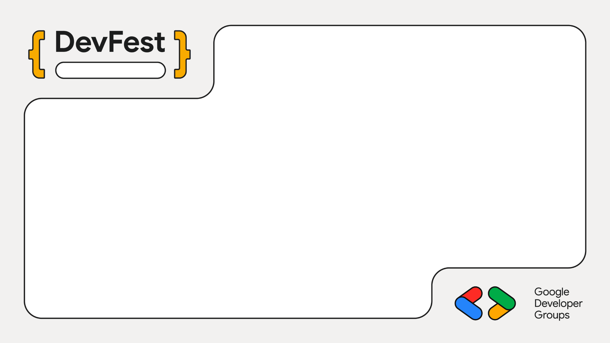
Nairobi, Kenya
Building Scalable Fire Safety Systems with Google Cloud & Angular
Name Melvin
GDG, 2025

Slide 2

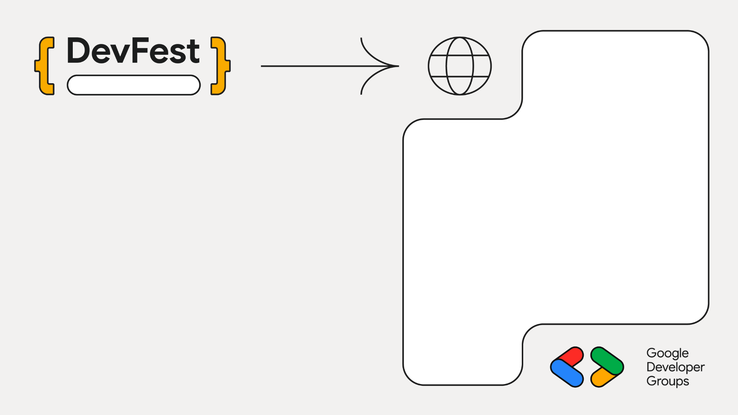
Nairobi, Kenya
Why This Matters – The Real-World Problem

Slide 3
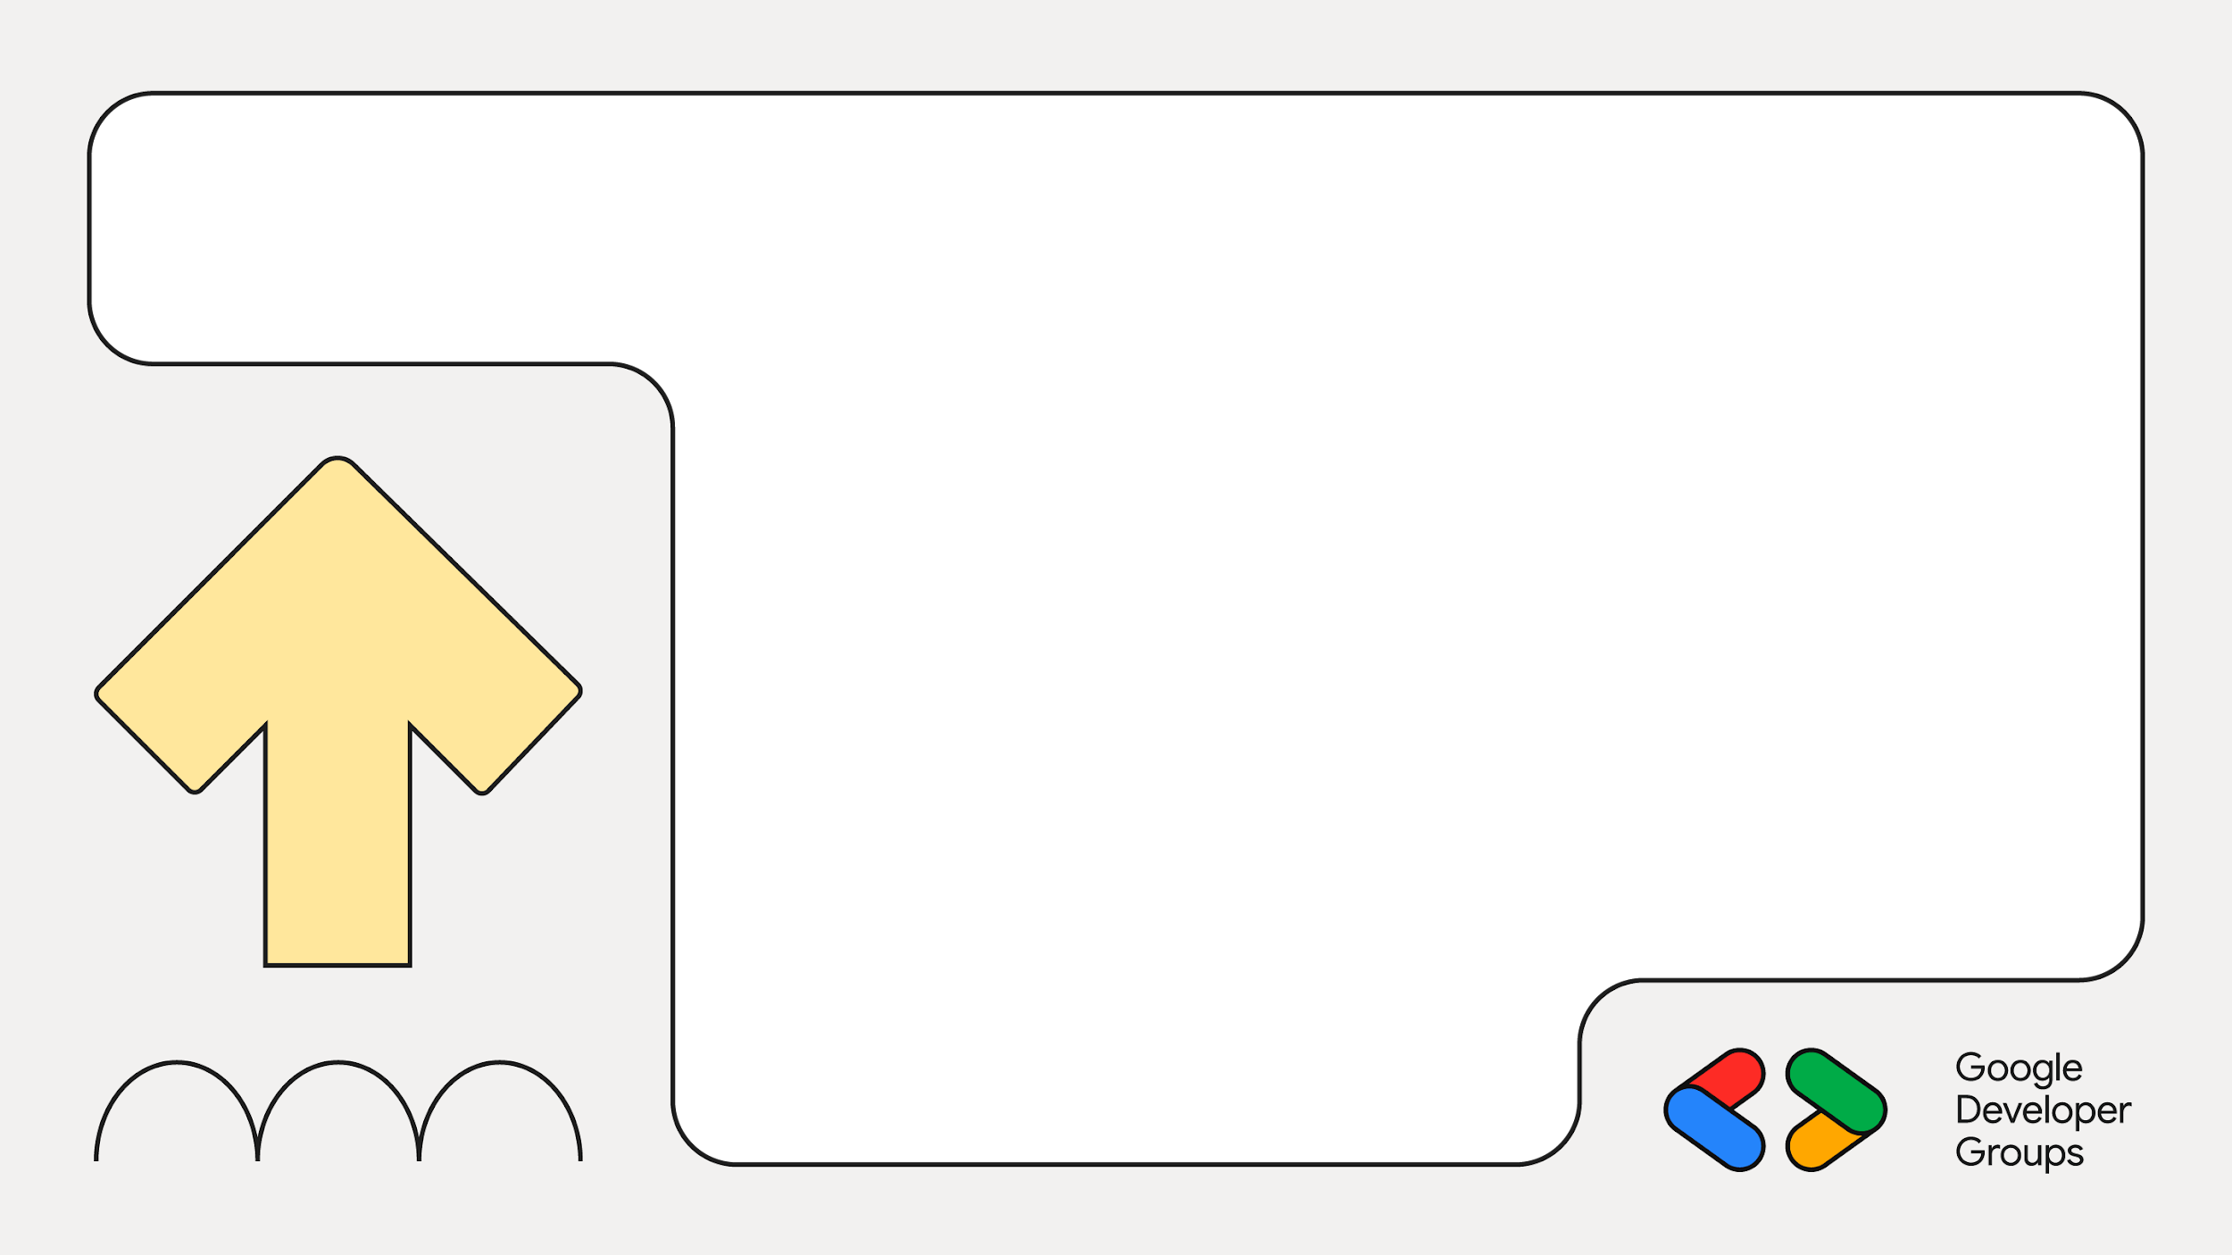
01
The Vision–Cloud-Native Fire Safety
From Hardware Silos to Cloud Platforms Sensors -> Relay -> Local Alarm -> Manual Response > Zero Data Intelligence > Can’t scale

Slide 4
02
Cloud-Native Approach
Sensors -> MQTT -> Google Cloud -> Angular dashboard >Centralized monitoring >Intelligent Processing >Data-driven insights

Slide 5
03
Why Google Cloud Powers This Platform

Slide 6
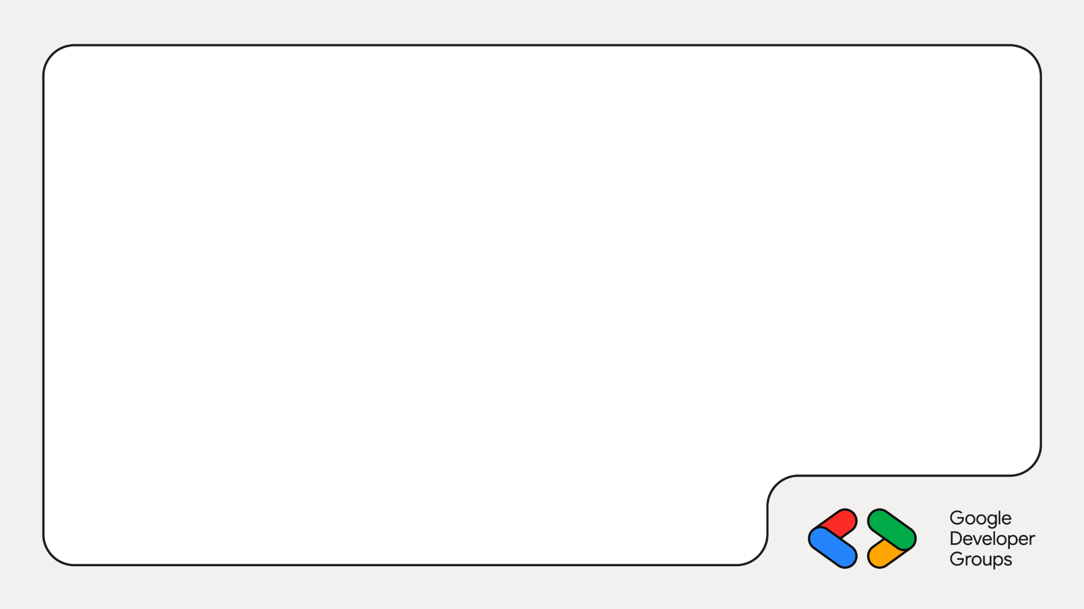
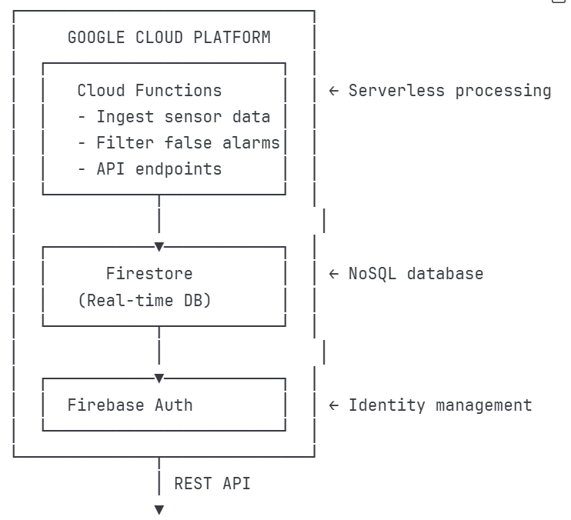

Slide 7
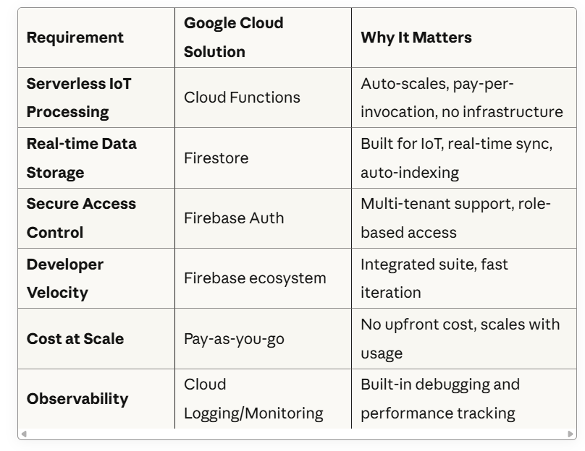
04
What Makes Google cloud the Right Choice

Slide 8
05
Component 1: Sensor Data Simulator
What It Does >Simulates flame, smoke, and temperature sensors >Publishes MQTT messages to Mosquitto broker >Creates realistic fire patterns (gradual heat rise, smoke before flame)

Slide 9
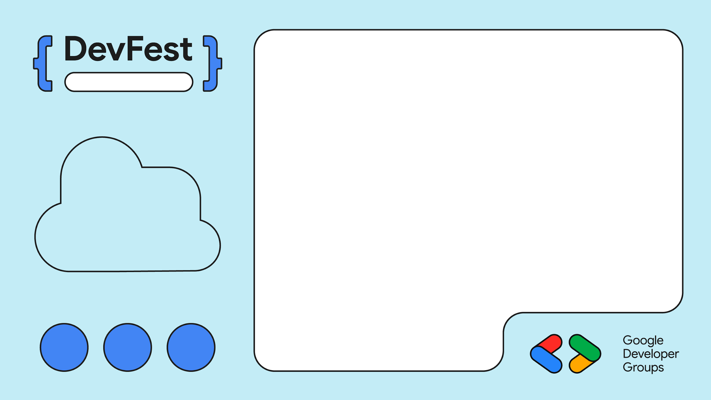
Component 2 – Mosquitto Broker
Editable Location
The IoT Messaging Layer Why MQTT? > Lightweight protocol designed for IoT > Publish/Subscribe pattern
> Docker Setup

Slide 10
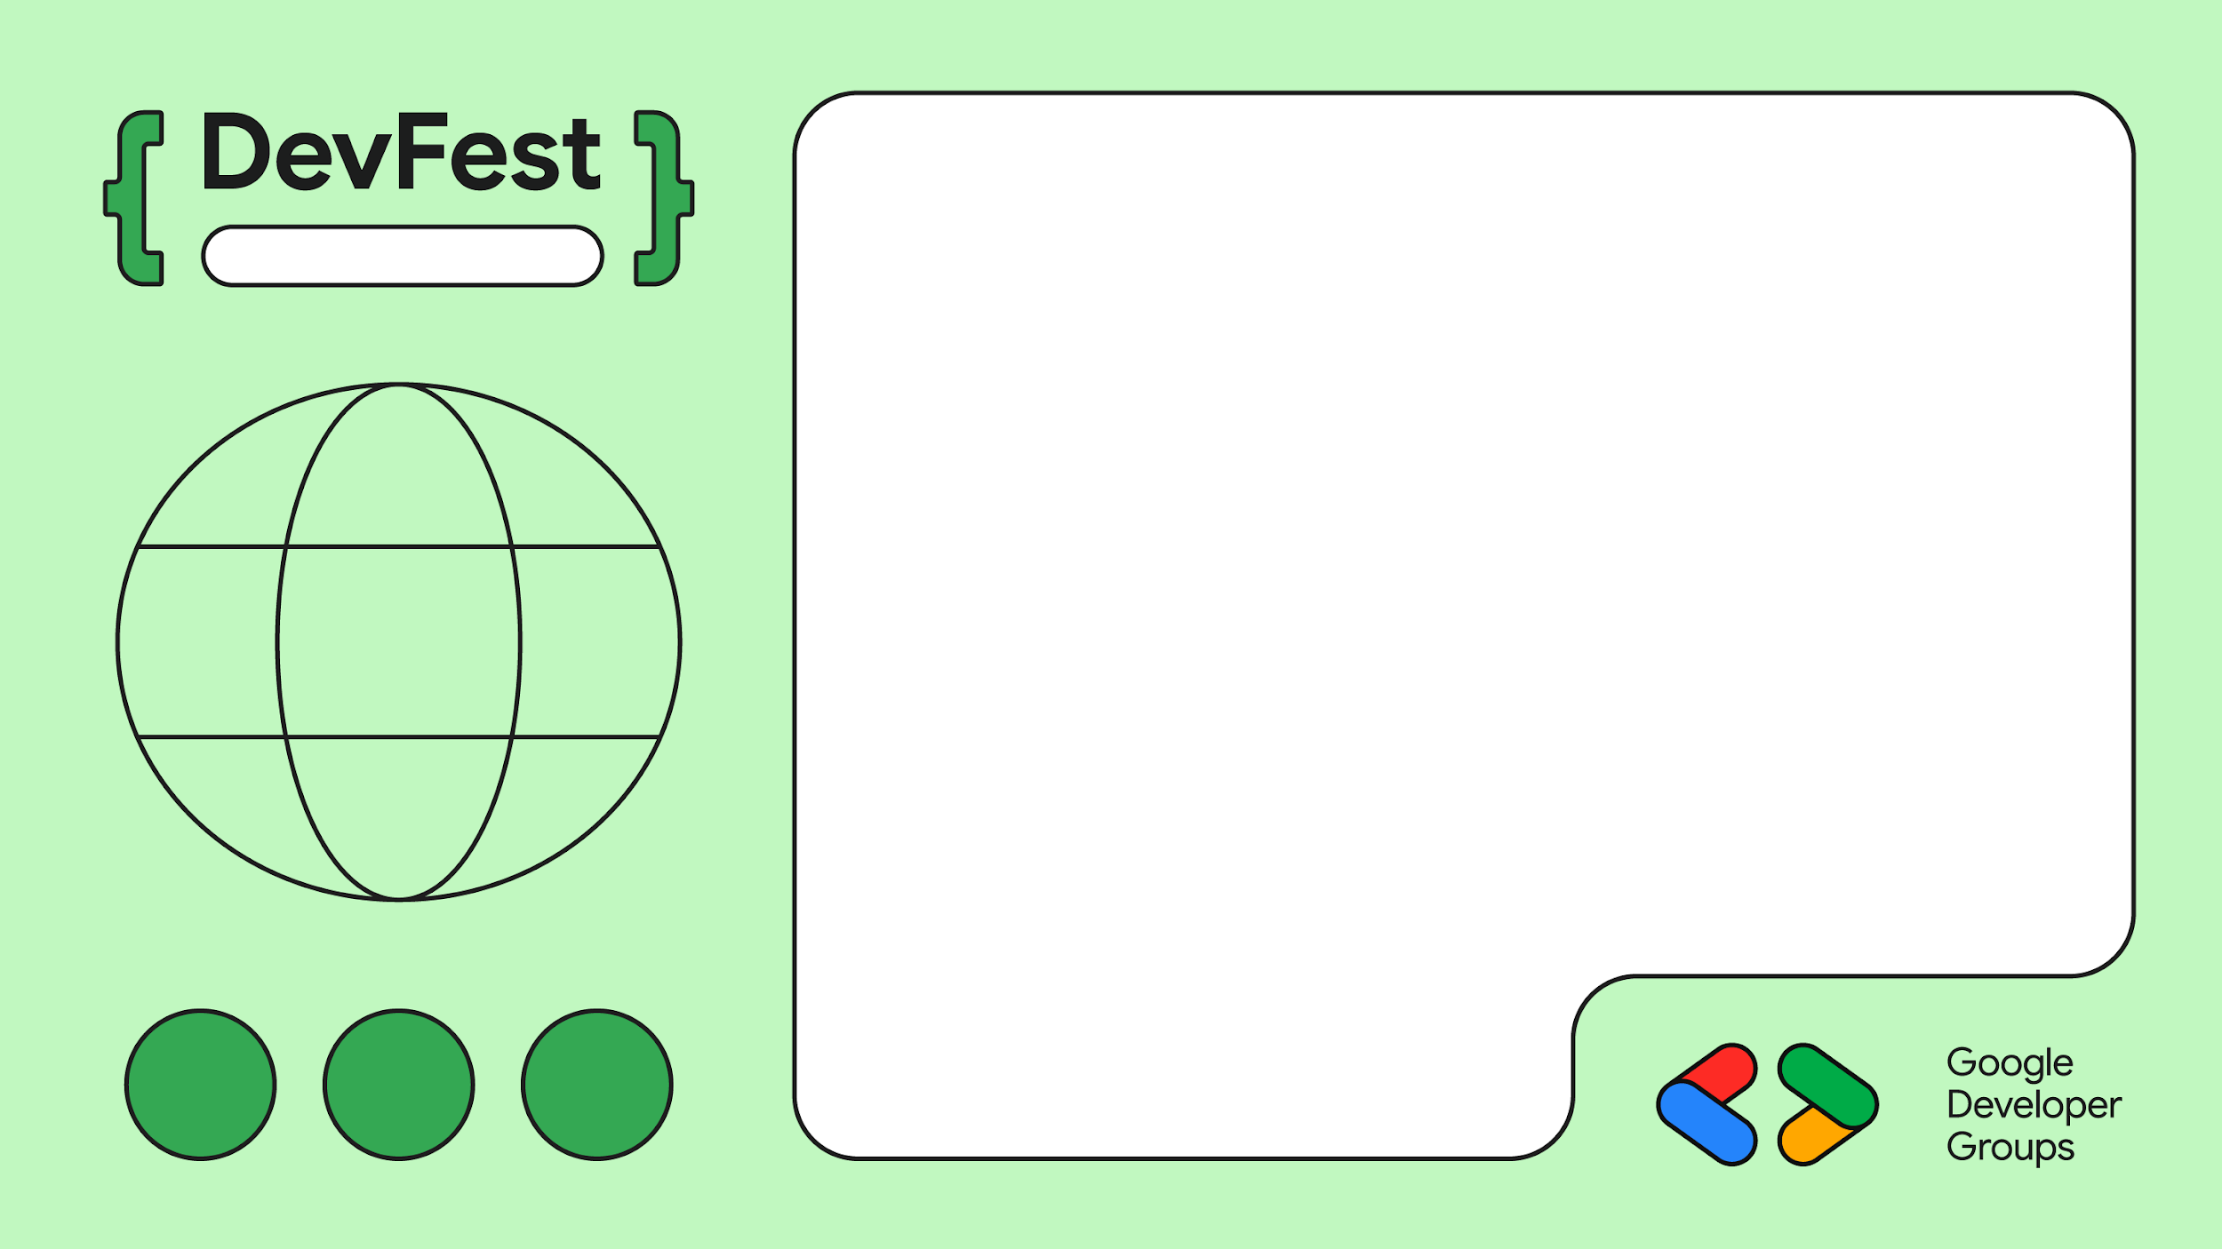
Editable Location
Component 3 – Cloud Functions (The Brain)
Traditional versus Cloud Functions

Slide 11
Traditional Approach:
> Maintain servers 24/7 > Handle scaling manually > Pay for idle time > Manage OS updates
Traditional Approach:
> Maintain servers 24/7 > Handle scaling manually > Pay for idle time > Manage OS updates

Slide 12
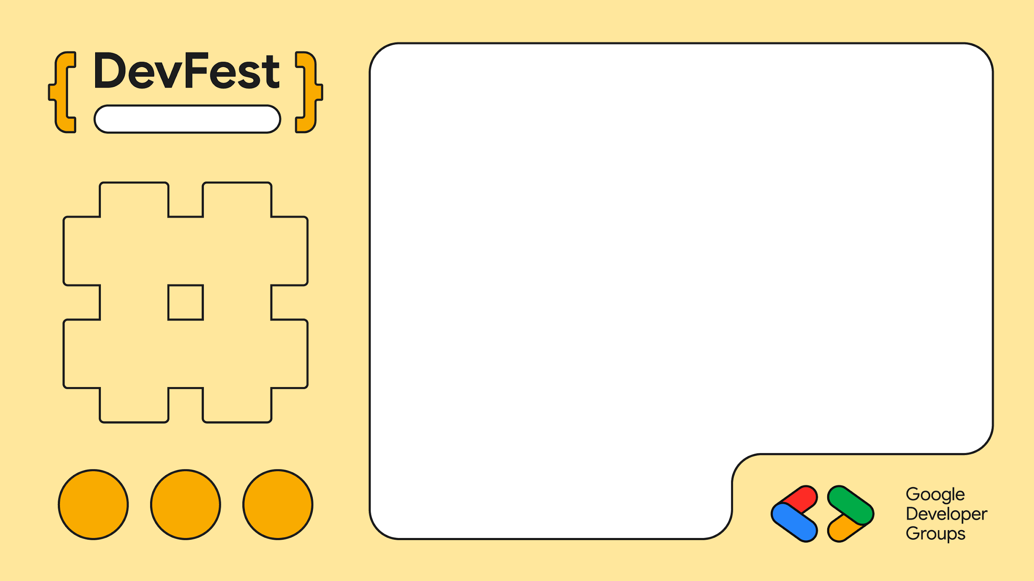
Editable Location
Cloud Functions – What They Actually Do
Three Core Functions
> Sensor data ingestion (HTTP Trigger)
> Alert Processing (FireStore Trigger)
> Dashboard API (HTTP Trigger)

Slide 13
Component 4 – Firestore Why Firestore is Perfect for IoT
Editable Location
> Flexible schema
> Real-time listeners
> Automatic indexing
> Offline support > Built-in security rules

Slide 14
Why Cloud Functions? The Economics & Scalability Scenario: 10 buildings, 50 Sensors each, reporting every 30 seconds >Cost: $50-200/month (always running) >Handles: 1,440 requests/day per sensor = 720,000 requests/day.
>The problem: What if you add 100 more buildings?

Slide 15
Serverless Computing
Handles the server infrastructure, allowing developers to focus on writing code that runs in response to specific events.

Slide 16
Component 5 – Angular Dashboard
Editable Location
Polling Cloud Functions API
Data Visualizations

Slide 17
What I planned vs What I Built The Reality of Building Real Systems
> Centralized Dashboard
> Intelligent false alarm filtering
> Multi-building support
> Cloud-native architecture
> Push notifications

Slide 18
The Reality of Building Real Systems
Simple Dashboard
With near real-time updates
False alarm reduction has higher impact than instant updates

Slide 19
Technical Insights
MQTT + Cloud Functions = Perfect Match
Polling before Websockets, iterate when needed
Google Cloud removes infrastructure friction so you focus on business logic.

Slide 20
Why This Matters for Your Projects
IoT/Sensor Applications
Real-Time Dashboards
Multi-Tenant SaaS
Event-Driven Systems

Slide 21
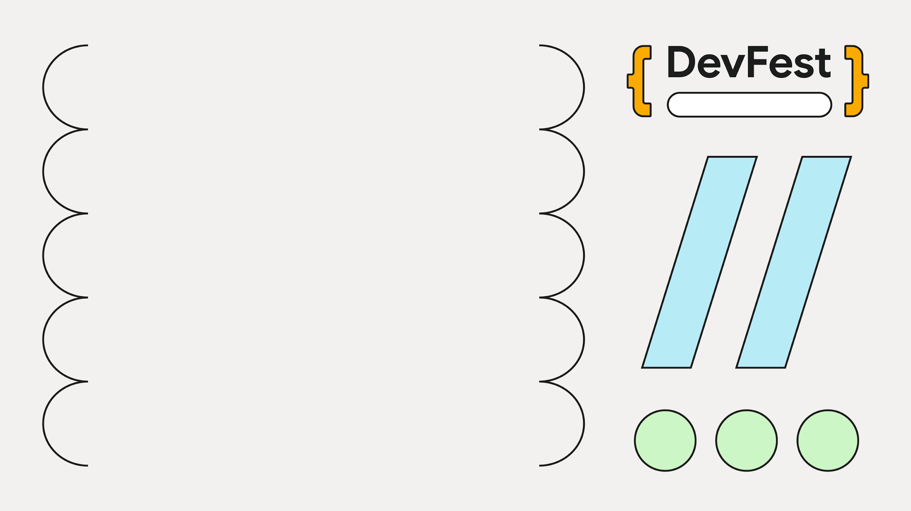
Editable Location
Connect with Me:
> Github: @/MelvinJosephh/ > LinkedIn: https://www.linkedin.com/in/melvin-njuguna-9a8253208/
> Email: melvinnjuguna.21@gmail.com

